Slide 1

Factorial Analysis of Variance
Instructor: Weikang Kao, Ph.D.

Slide 2
Names for different ANOVA designs
ANOVAs are named by how many factors in the design
One-way ANOVA: we have one factor (or IV)
Two-way ANOVA: there are two factors (or IVs) in the design
ANOVAs are also named in terms of how subjects receive factors, treatments, and blocks: between/ within design.
Between-group effects are the effects between treatment groups, which has no commonality.
Within-group effects are the effects that within subjects/groups/blocks, which have a commonality across treatments.

Slide 3
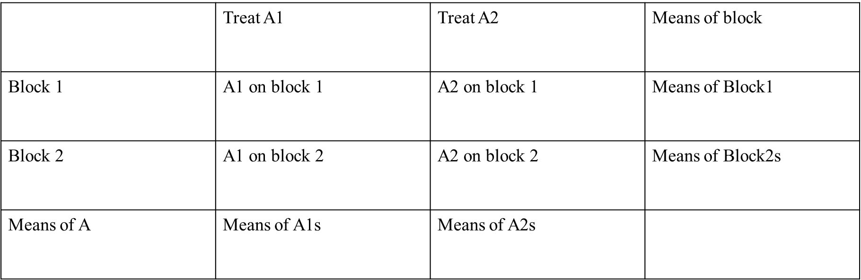
Blocked Design
When to use a blocked ANOVA design?
We have treatment (one predictor here) and participants. We recognize the participants and then put them into subgroups (block).

Slide 4
Factorial ANOVA
We talked about one-way ANOVA, meaning we have one predictor to be tested.
What if we have more than one, which is very possible in practice?
A factorial ANOVA is an Analysis of Variance test with more than one independent variable. It can also refer to more than one Level of Independent Variable.

Slide 5
Factorial ANOVA
One-Way ANOVA:
Total = Treatment A + Error
Factorial ANOVA:
Total = Treatment A + Treatment B + Treatment C ….. + Error
Total = Treatment A + Treatment B + Treatment A*B ….. + Error

Slide 6
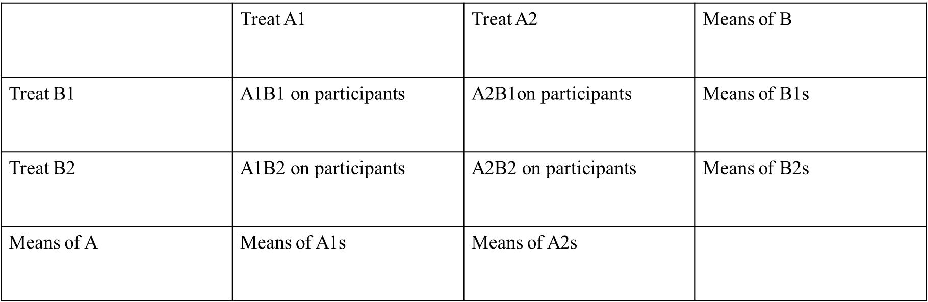
Factorial ANOVA
When to use it?
When we have TWO treatments/factors (we will use A and B to represent them in the class). The treatments/ factors (A and B) with 2 or more levels for each treatment.

Slide 7
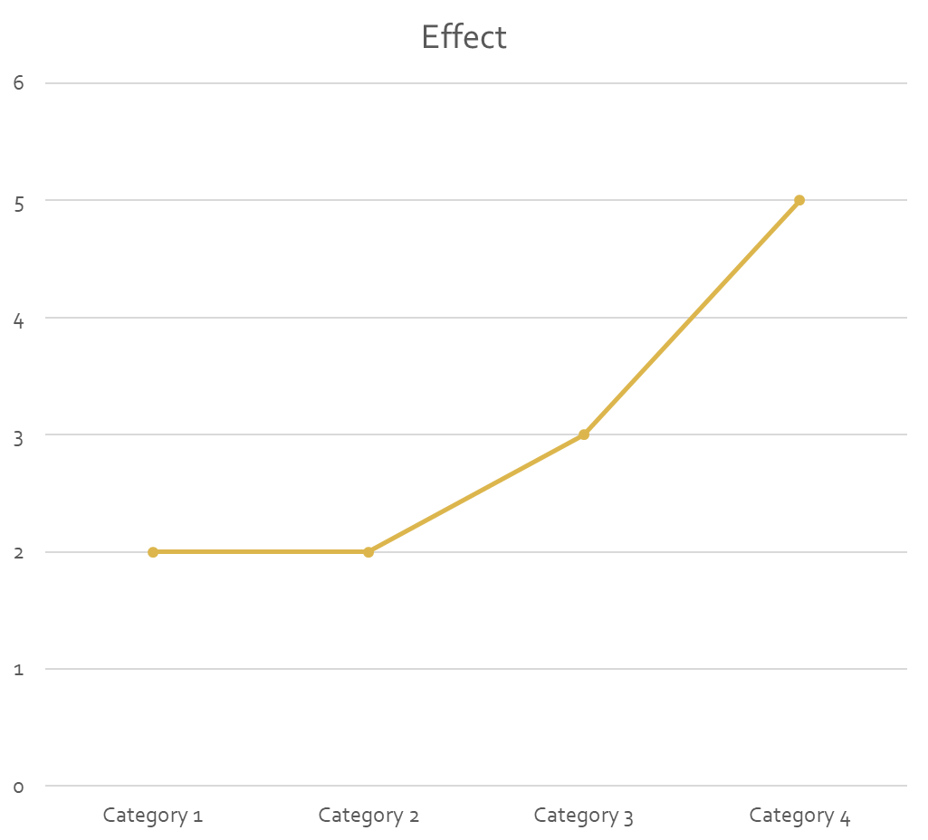
One-Way ANOVA
When performing a one-way ANOVA, we focus on the main effect. That is, for example, how the value changes from different points/groups.

Slide 8
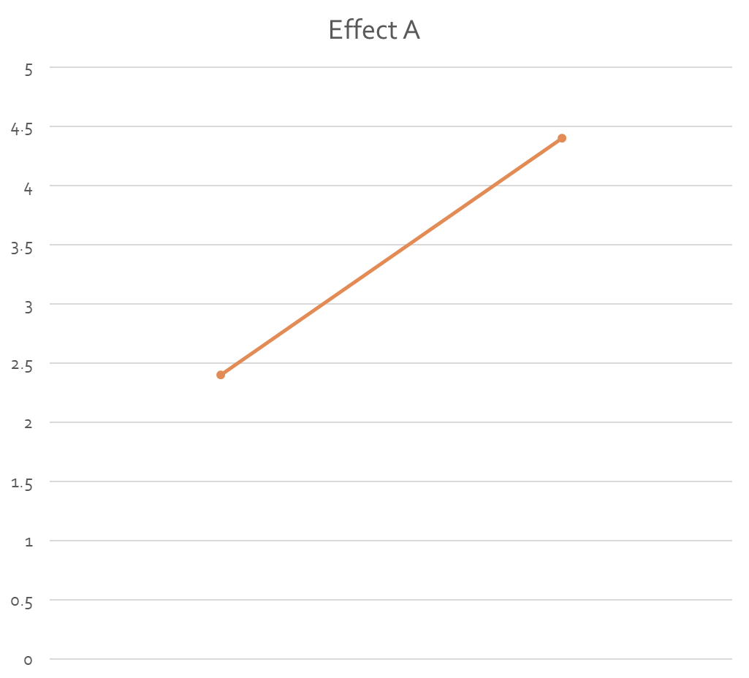
A Factorial Design
When we perform a factorial design, remember that we have multiple effects now.
For example, we will have IV A and IV B, which represented different treatments.
Effect A

Slide 9
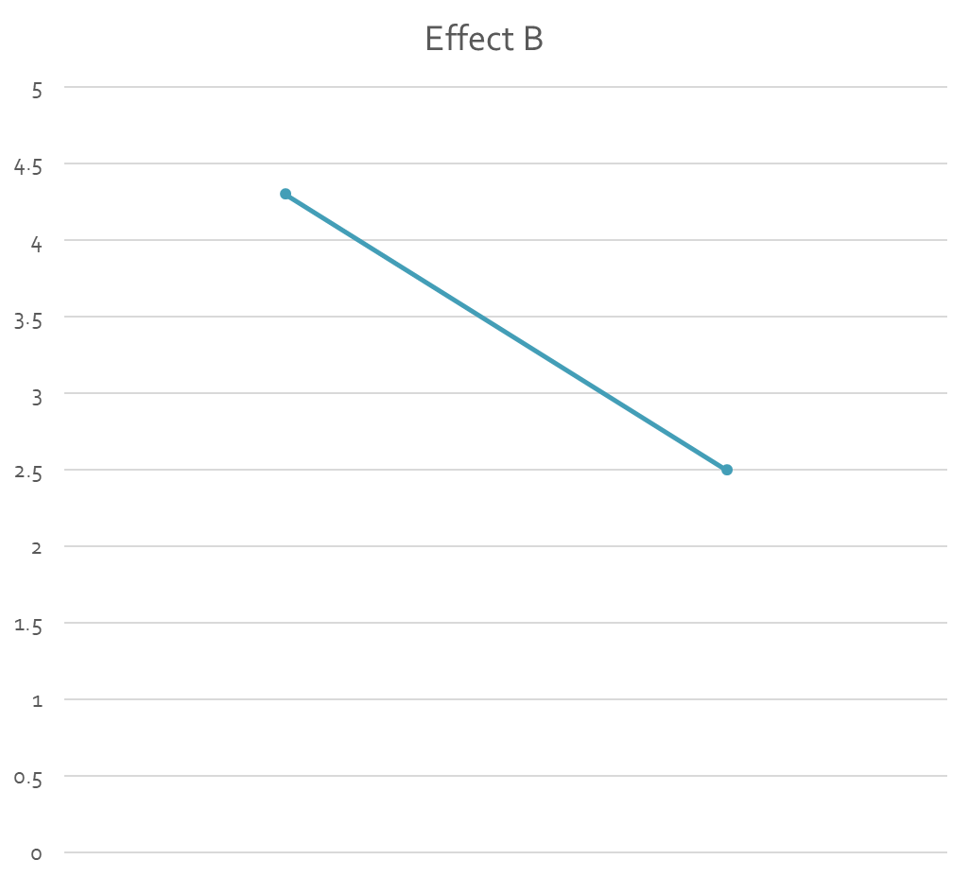
A Factorial Design
If we look at them separately, we can examine the main effects.
Effect B

Slide 10
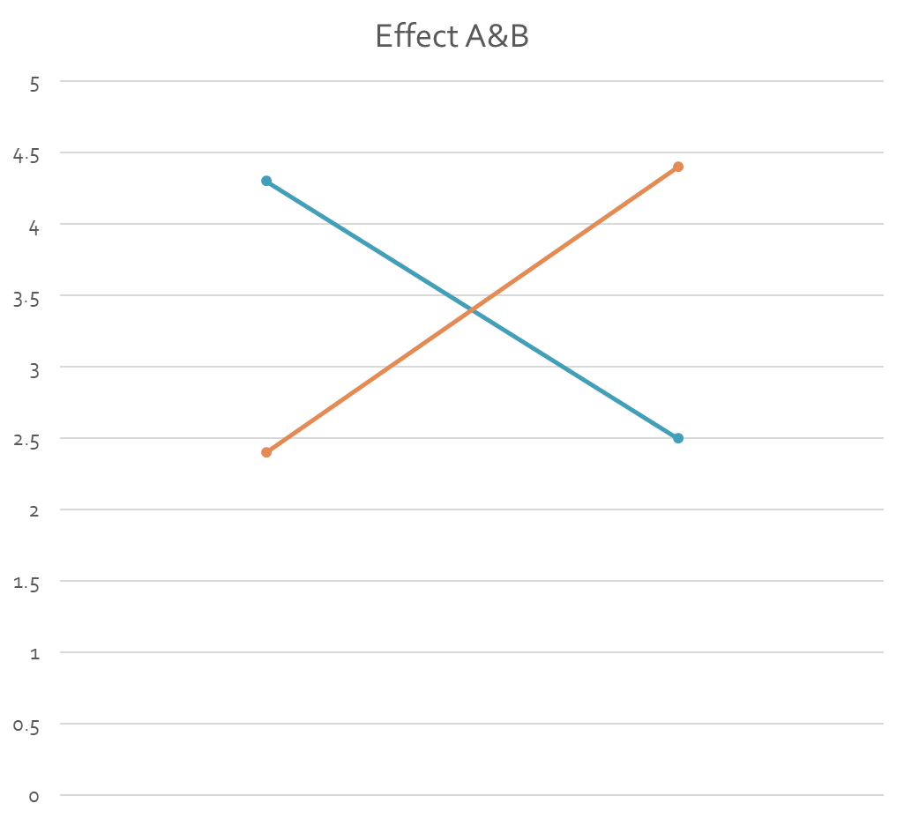
A Factorial Design
When we perform a factorial design, remember that we have multiple effects now.
If the design is a two-way ANOVA design, that means we have two predictors, and we will have two main effects and an interaction effects (potentially).

Slide 11
Interaction Effect
Interaction effects represent the combined effects of factors on the dependent measure.
Sometimes if we only look at main effects, we are not able to find out what happened.
One of the reasons we want to include interactions is that they can hide effects that exist or make us believe in effects that don’t exist.

Slide 12
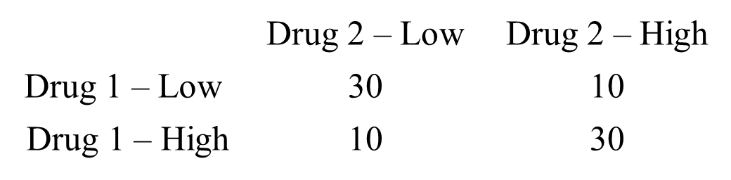
Interaction Effect
For example, if we ran a study looking at the effects of two drugs (both taken at a high or low level) and got the following result. What do you think we would find if we ignored the interaction?
Drug 1s’ effect would be: (𝟑𝟎+𝟏𝟎)/𝟐−(𝟏𝟎+𝟑𝟎)/𝟐=𝟎
Drug 2s’ effect would be: (𝟑𝟎+𝟏𝟎)/𝟐−(𝟏𝟎+𝟑𝟎)/𝟐=𝟎
Thus we would conclude neither drug has any effect at all. But is that the real story here?

Slide 13
Interaction Effect
For example, now we are running a test to see if soda and candy would have impacts to individuals’ weights.
IV A: Soda
IV B: Candy
DV: Weight

Slide 14
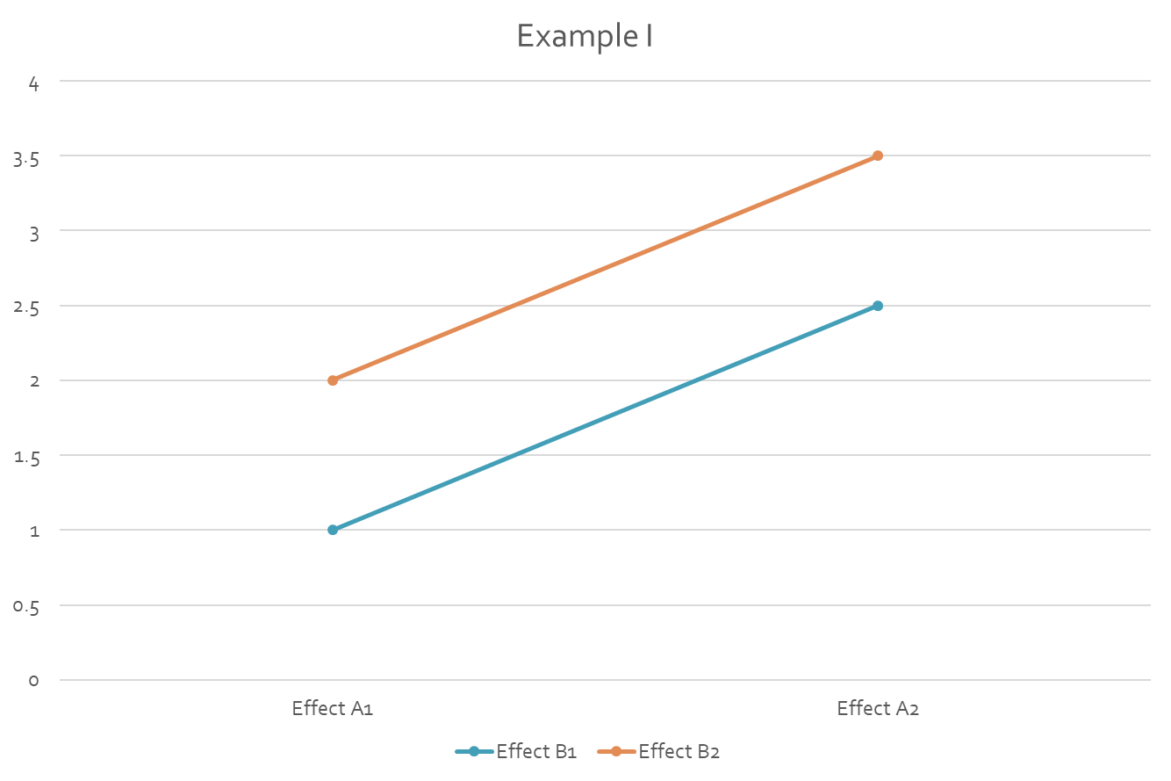
Interaction Effect
First scenario, both soda and candy work, but there is no interaction effect.
What do we find here?
“no interaction”

Slide 15
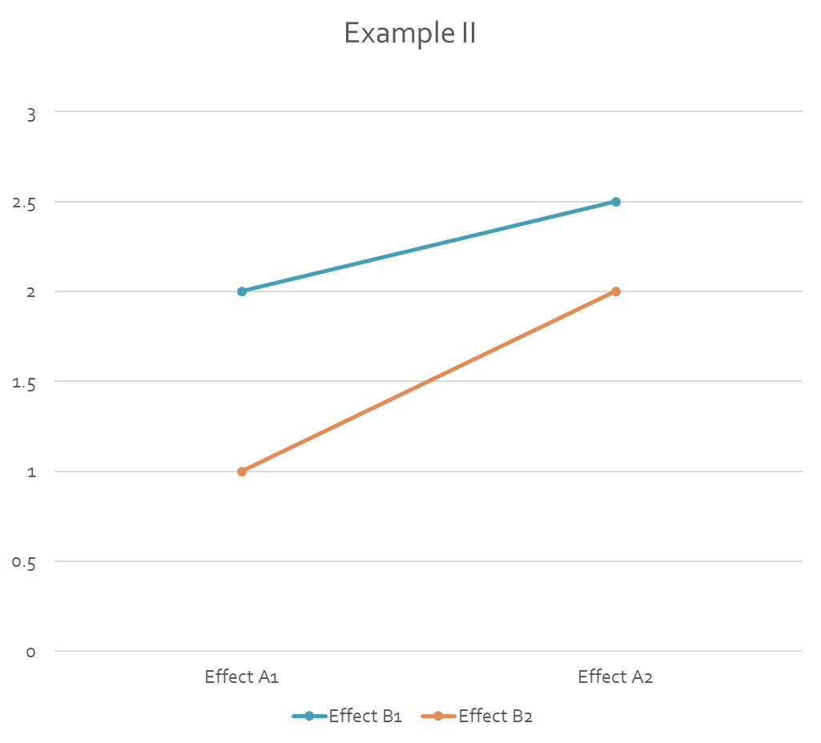
Interaction Effect
Second scenario, both soda and candy work, and there is an interaction effect.
What do we find here?
“Ordinal Interaction ”

Slide 16
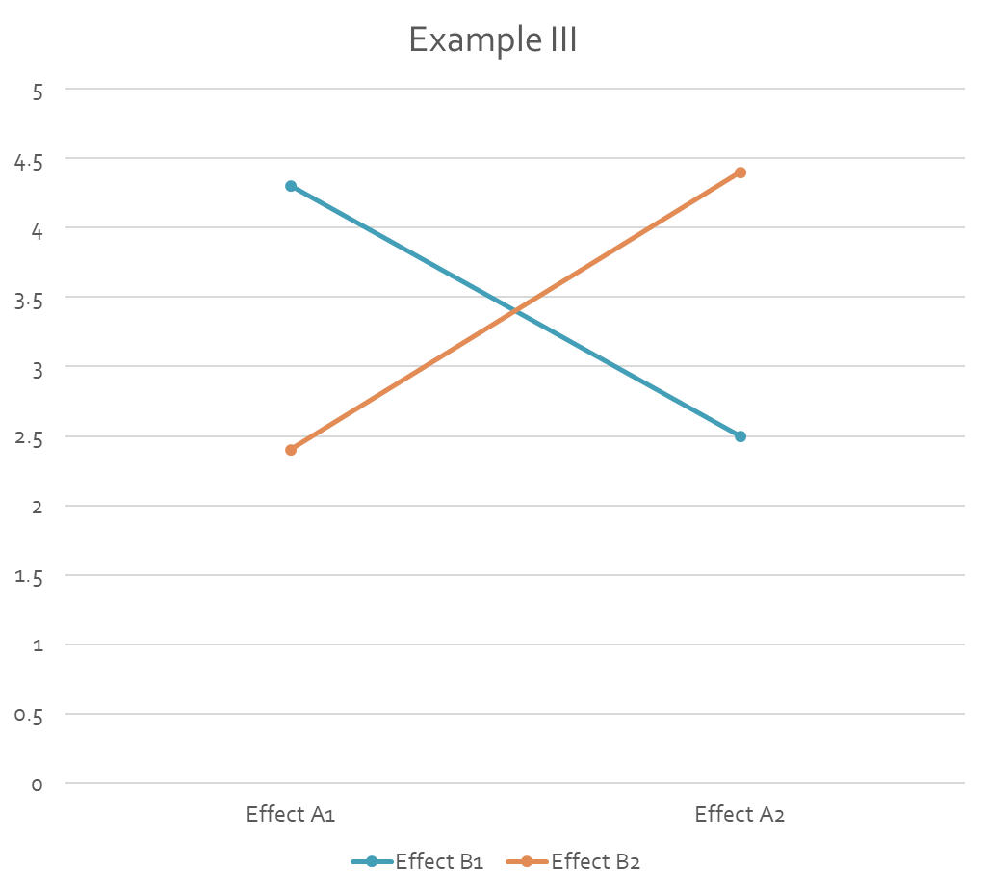
Interaction Effect
Third scenario, both soda and candy work, and there is an interaction effect.
What do we find here?
“Disordinal Interaction”

Slide 17
Main Effect
Main effect: the means across levels of treatment A are different, and to the same degree for all levels of treatment B.
Example: Eating candy (IVA) will increase individuals’ risk of death, with the same degree for all individuals who are also drinking soda (IVB).

Slide 18
Interaction Effect
An interaction effect implies that: the effects at a specific level of treatment A across levels of treatment B is different than the effects (same) at another level of treatment A across levels of treatment B.
If there is an interaction effect, then we must look at the simple main effect rather than the original main effect.

Slide 19
Simple Main Effect
A simple main effect is a main effect of one factor at a given level of a second factor, in other words, how the DV varies across levels of treatment A with a specific level of treatment B.
Example:
Eating candy (IVA) will increase individuals’ risk of death more, for those individuals who drink soda (IVB1) than those individuals who don’t drink soda (IVB2).
Drinking soda (IVB) will increase individuals’ risk of death more, for those individuals who eat candy (IVA1) than those individuals who don’t eat candy (IVA2).

Slide 20
SS in factorial design
Recall: when we do one-way ANOVA, what is the total SS?
Total SS = SSB + SSW = SStreatment effect + SSerror
Blocking:
Total SS = SSB + SSW = SStreatment effect + SSblock + SSerror
Factorial:
Total SS = SSB + SSW
= SSA + SSB + SSintercation+ SSerror

Slide 21
Assumptions
Normality
Observations are drawn from a normally distributed population.
Independence of observations
Observations are randomly sampled from the population , or subjects are randomly assigned to treatment groups, so that all the observations in the within groups and the between groups are independent.
Equal variance
The observations have equal variances across groups.

Slide 22

Application

Slide 23
Factorial Design: Procedure
Propose a research question(s) based on your questions.
Perform a (or more) hypotheses
Check the assumptions
Perform tests
Make conclusions based on the finding.

Slide 24
Application
The data set from the first class contains another column that includes whether the valuation was made for a product or gamble so we have data that we can analyze using a factorial ANOVA.
In our example we have a 3 X 2 design, so we need at least six observations where each observation was randomly and independently generated under the same circumstances.
Use the ANOVAexample.

Slide 25
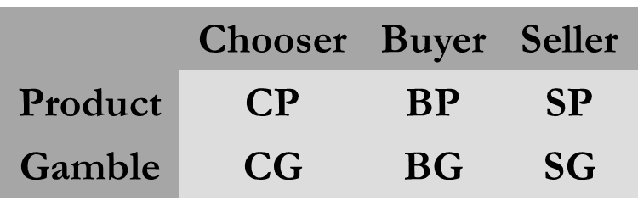
Application
Most of the time we are going to want to employ a factorial design when we have more than one factor of interest.
For example, if we are interested in the effects of Perspective and Item Type and their potential interaction effects, we would set up our experiment so that each factor is present at each other factors levels

Slide 26
Application
In this case, we have two IVs:
model <- aov(V2 ~ Condition*ProductorGamble, data = ANOVAExample)
Perspective and item type are significant, their interaction is not. Let’s plot the interaction anyways.
interaction.plot(ANOVAExample$Condition, ANOVAExample$ProductorGamble, ANOVAExample$V2)
Note we can also make inferences about our main effects
from this as well: Products > Gambles, Sellers > Buyers

Slide 27
Summary write up
A study was conducted to investigate whether, taken together, a person’s status and product gamble form affected individuals’ valuation of the product. Observations from the study were analyzed by conducting a two-way analysis of variance with the two independent variables (condition and product or gamble) and the dependent variable (valuation) using R version 3.61.
First, all assumptions are met and there is no adjustment made. ANOVA analysis revealed there is no statistically significant interaction effect (F(2, 234) = 2.698, p = .070). Results also suggest that the valuations of an item’s worth was affected by the status of (as buyers, sellers, or choosers) the participants (F(2, 234) = 23.45, p < .001) and product or gamble (F(1, 234) = 43.98, p < .001).
Post hoc tests…….
Effect size ……

Slide 28
In Class Practice
In a current study, we want to test if the two types of drugs with different levels, will have impacts on individuals' stamina.
Use the data “Week 4 Practice”.
IVs?
DV?

Slide 29

Three-Way Interaction

Slide 30
Understanding a 3 Way Interaction
What if we get a significant 3-way interaction? How do we interpret it?
More than two-way interactions can get confusing.
The best way to understand them is to make plots as we did before, but to do so for each level of our third factor (here I present data from a study looking at the effects of two different drugs taken on full or empty stomachs).

Slide 31
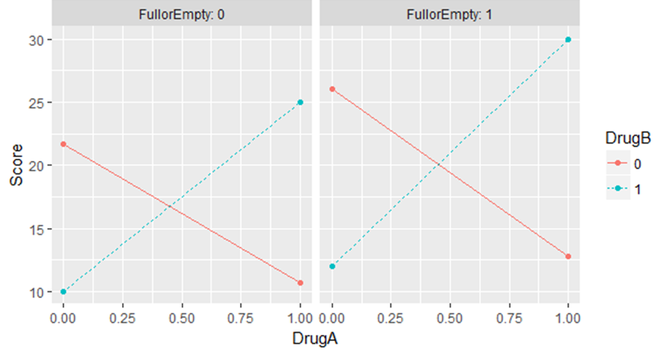
Three-Way Interaction
Use two plots to interpret your findings

Slide 32
To Interact or Not?
Generally if you have a two-way (or greater) ANOVA you will want to see if your factors interact.
What if you fit the model with the interaction and it is not significant. Can you remove it?
Some say yes, if it is not significant you can safely ignore it and therefore should not include it in your model (the same could be said for any non-significant predictor).
Others would argue that even if not significant you should include it to control for any effect that is present in the interaction (you'll likely have to report it in academics anyways).
I would base such decisions on the goals of your analysis (build a model vs. test a hypothesis).

Slide 33

Blocking in Factorial Designs

Slide 34
Blocking in Factorial Designs
Just like with one-way (one-factor) experiments with lots of levels running a factorial study can also make it difficult to ensure all factorial combinations are sampled under the same conditions.
To remedy this we can control for those potential confounds up front by blocking.
Ideally will use a randomized complete block design – each factorial combination is present in each block (equally often) and the assignment of those factorial combinations is random within the block.
We would also need to make sure we don’t have any interaction with that blocking factor.

Slide 35
Blocking in Factorial Designs: Application
Check the basic assumptions.
Check the additivity of interaction:
model <- aov(V2 ~ Condition*ProductorGamble*Session, data = ANOVAExample)
We find no interactions with our blocking factor so we are good to go ahead and run the analysis as such:
model <- aov(V2 ~ Condition*ProductorGamble + Session, data = ANOVAExample)
In this case the effect of our blocking variable was very small so there is no notable difference between the analysis including it and the one we preformed previously excluding it.
Nevertheless, its always best to include these confounding factors as they can in some instances mask effects or cause effects to be mis-interpreted.

Slide 36

Some Non-Parametric Tests

Slide 37
Non-Parametric
As we discussed when we violate the assumptions of ANOVA one option is to turn to non-parametric tests.
If we have a one-way ANOVA we can use the Kruskal Wallis test:
kruskal.test(y ~ X1, data = XXX)
If we have a one-way ANOVA with blocking we can use the Friedman test:
friedman.test(y, X1, Blocking Factor, data = XXX)

Slide 38
Non-Parametric
When we are dealing with some variations of factorial ANOVA we can use the Scheirer-Ray-Hare test:
scheirerRayHare(y ~ X1 x X2, data = XXX)
Generally speaking, ANOVA will be robust to small violations of our standard assumptions (non-normal data, unequal variances, etc.).
Nevertheless, its always a good idea to double check your analyses to be sure.

Slide 39

Weekly Lab
Why must we include interactions in factorial experiments?
If we find a higher order interaction is significant but its lower order components are not should we include the lower order components?

